Slide 1



TRAIN TICKET BOOKING SYSTEM
DEPARTMENT OF ELECTRONICS AND INSTRUMENTATION ENGINEERING
MICRO PROJECT
JAVA PROGRAMMING
BY
DHANUSRI P -23EIR022
DHARSHINI K S -23EIR023
DHARUN P -23EIR024

Slide 2
ABSTRACT This project presents a train ticket booking system that streamlines the process of passenger registration, train selection, and payment. The system maintains a list of passengers and checks if a user is registered based on their phone number or date of birth. If the user is not registered, they can easily register. The system displays train schedules sorted by departure time, allowing the user to select a train for booking. It provides payment options, including cash and online transactions. For online payments, the system checks the user’s bank balance before proceeding with the transaction, ensuring a secure and efficient booking experience.

Slide 3
PROBLEM STATEMENT:
1. Maintain Passenger List: Store 5 passengers with details like name, phone number, city, and date of birth.
2. User Input: Ask the user to provide their date of birth or phone number.
3. Check Existing User: Verify if the user is in the existing list. If not, allow registration.
4. Display Train Schedule: List train numbers, names, cities, scheduled times, and departure times sorted by scheduled time.
5.Train Booking: Ask the user to select a train number to proceed with booking. Display a confirmation message.
6. Payment Options: Show the price and offer payment options (cash or internet).
- If cash : Print "Booking completed successfully."
- If internet transaction : Ask the user to check their bank balance using a separate banking system.
7. Transaction Check: Proceed with the transaction only if the bank balance is sufficient.
This flow allows the user to register, select a train, and complete payment through either cash or an online transaction.

Slide 4
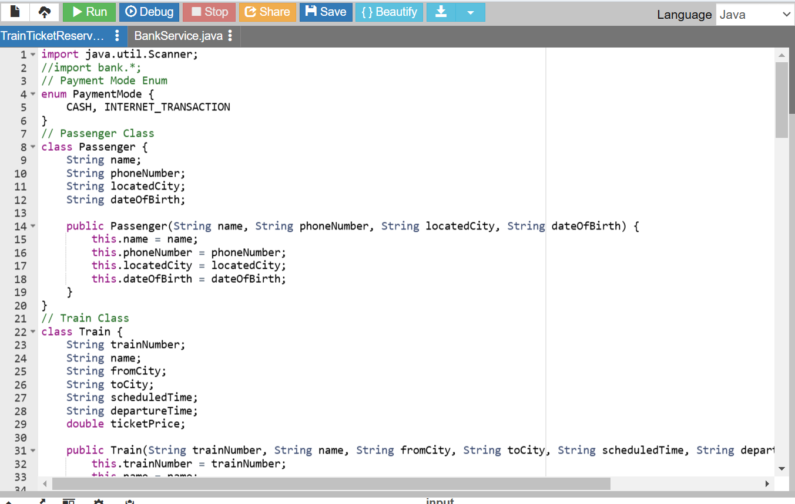
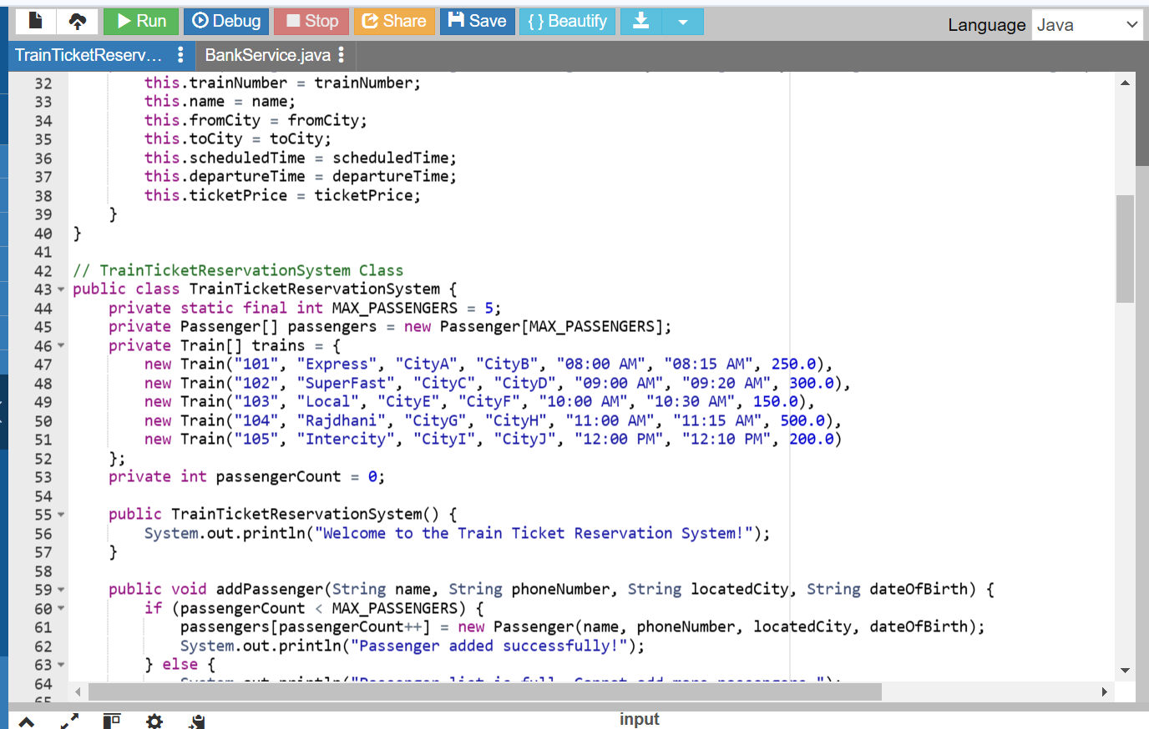
SAMPLE PROGRAM :

Slide 5
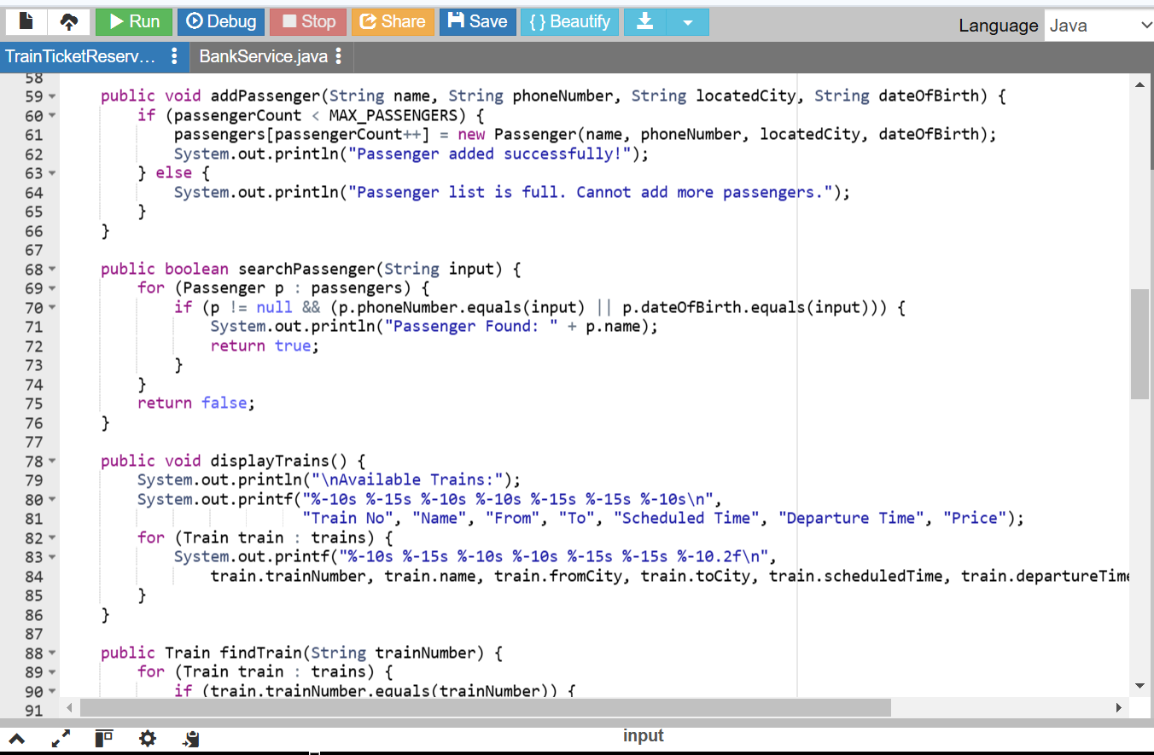
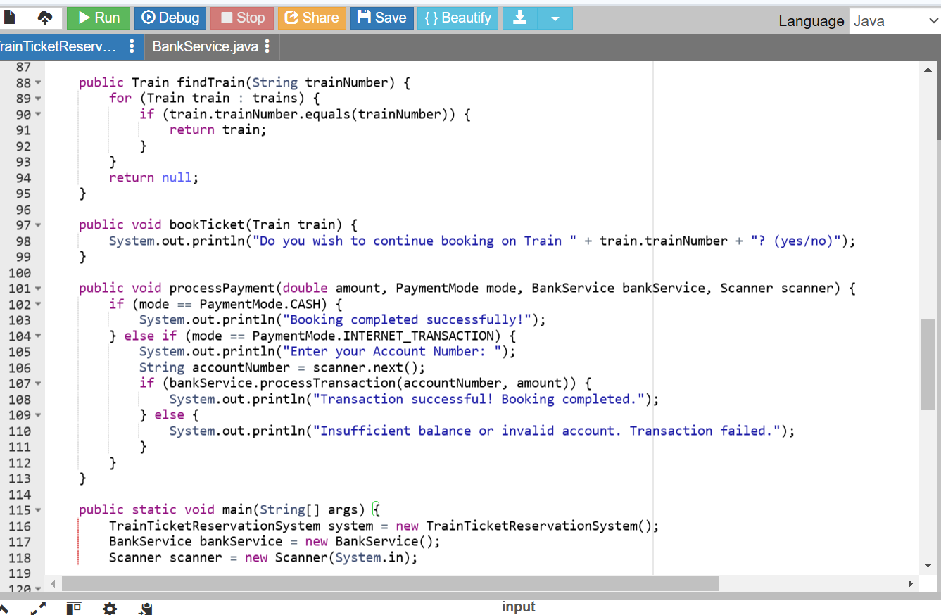

Slide 6
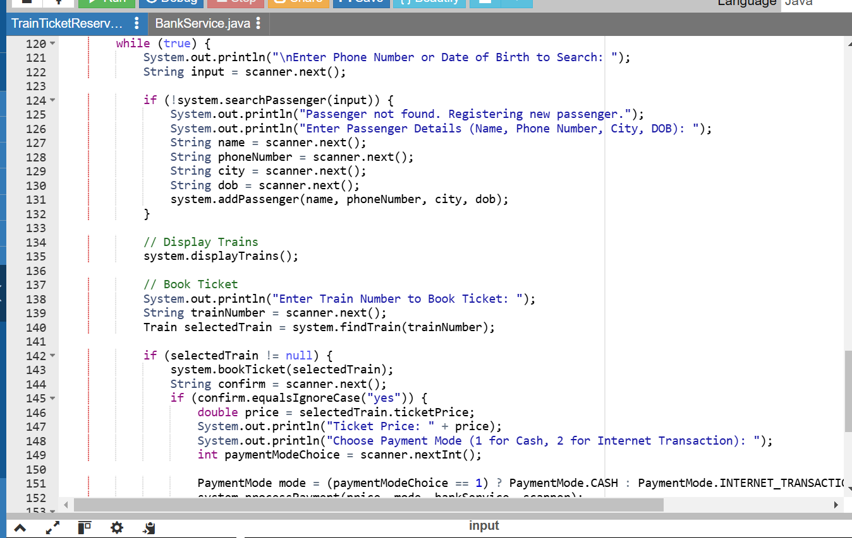
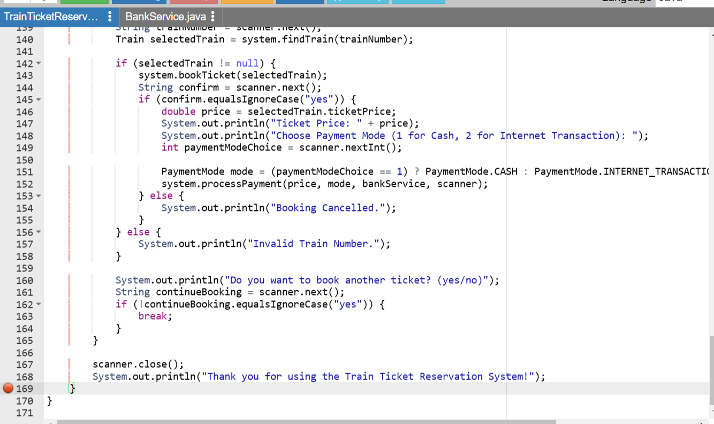

Slide 7
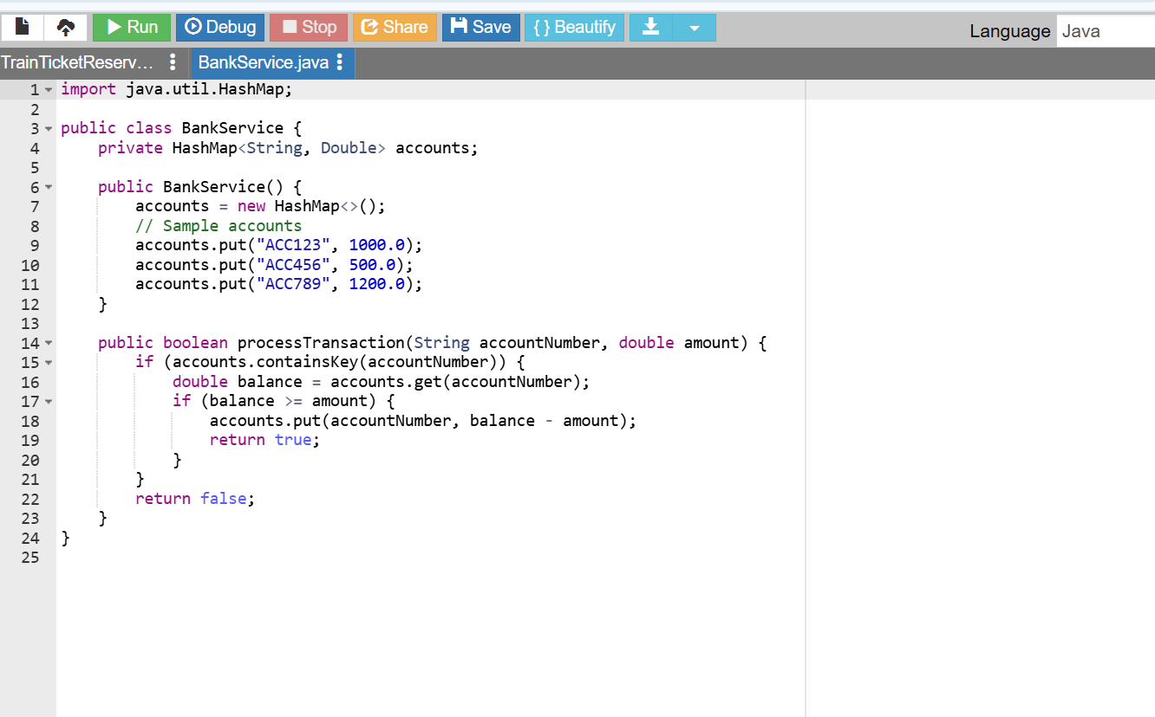

Slide 8
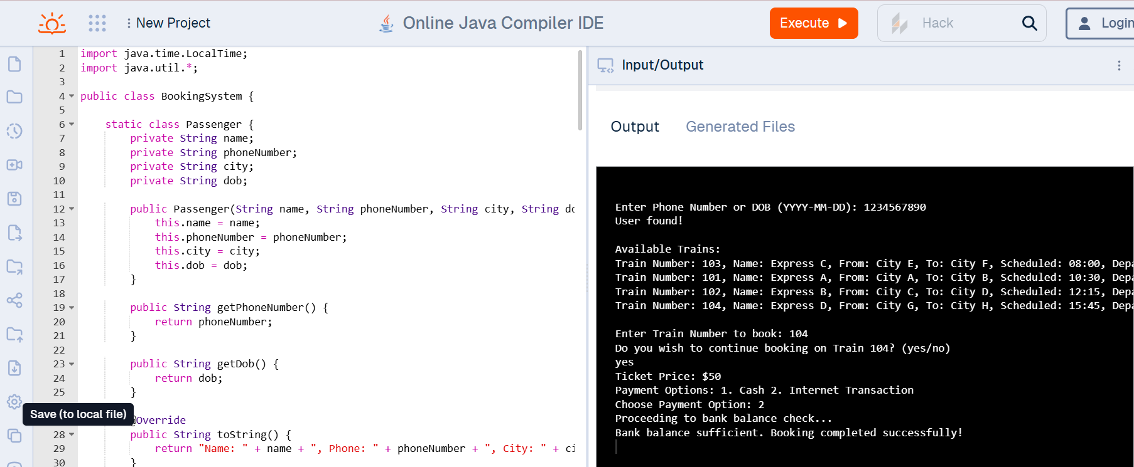
OUTPUT:

Slide 9
CONCLUSION :
The train ticket booking system successfully automates passenger registration, train selection, and payment processing, improving efficiency and user experience. By offering both cash and online payment options, the system caters to different user preferences. It ensures secure transactions by checking bank balances before processing online payments. Although the system can be further enhanced with real-time updates and additional features, it serves as an effective solution for modernizing train ticket booking, providing a scalable and user-friendly platform.

Slide 10
THANK YOU

